Slide 1
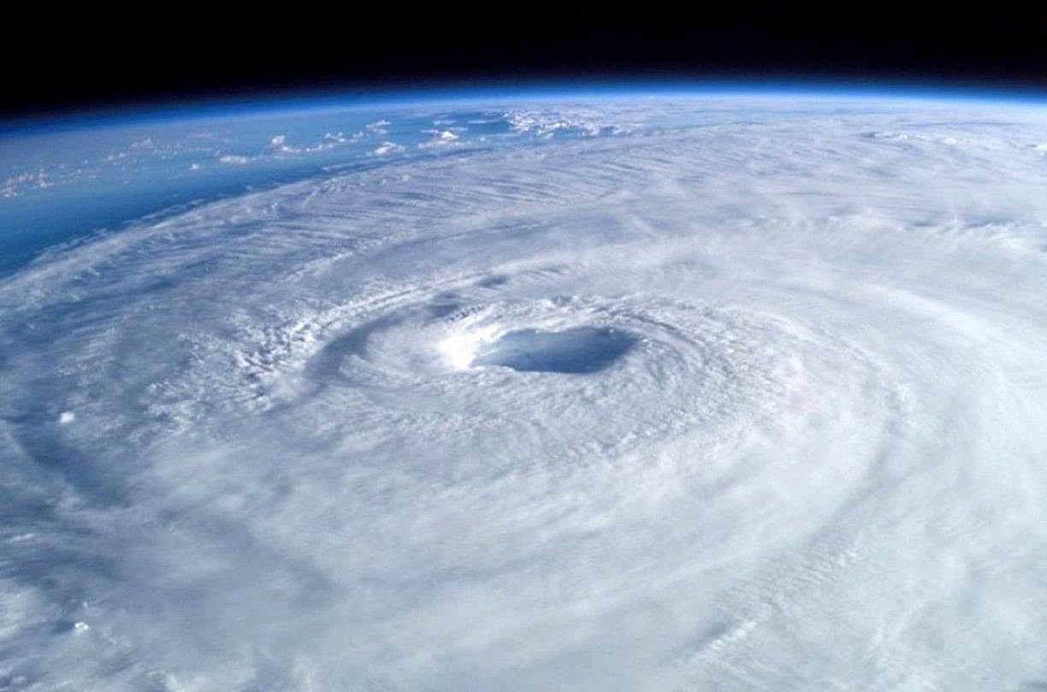

U.S. VIRGIN ISLANDS
COMMISSIONER’S HURRICANE SURVIVAL
TOOLBOX KIT
Hurricane Season 2025
Are You Ready?

Slide 2
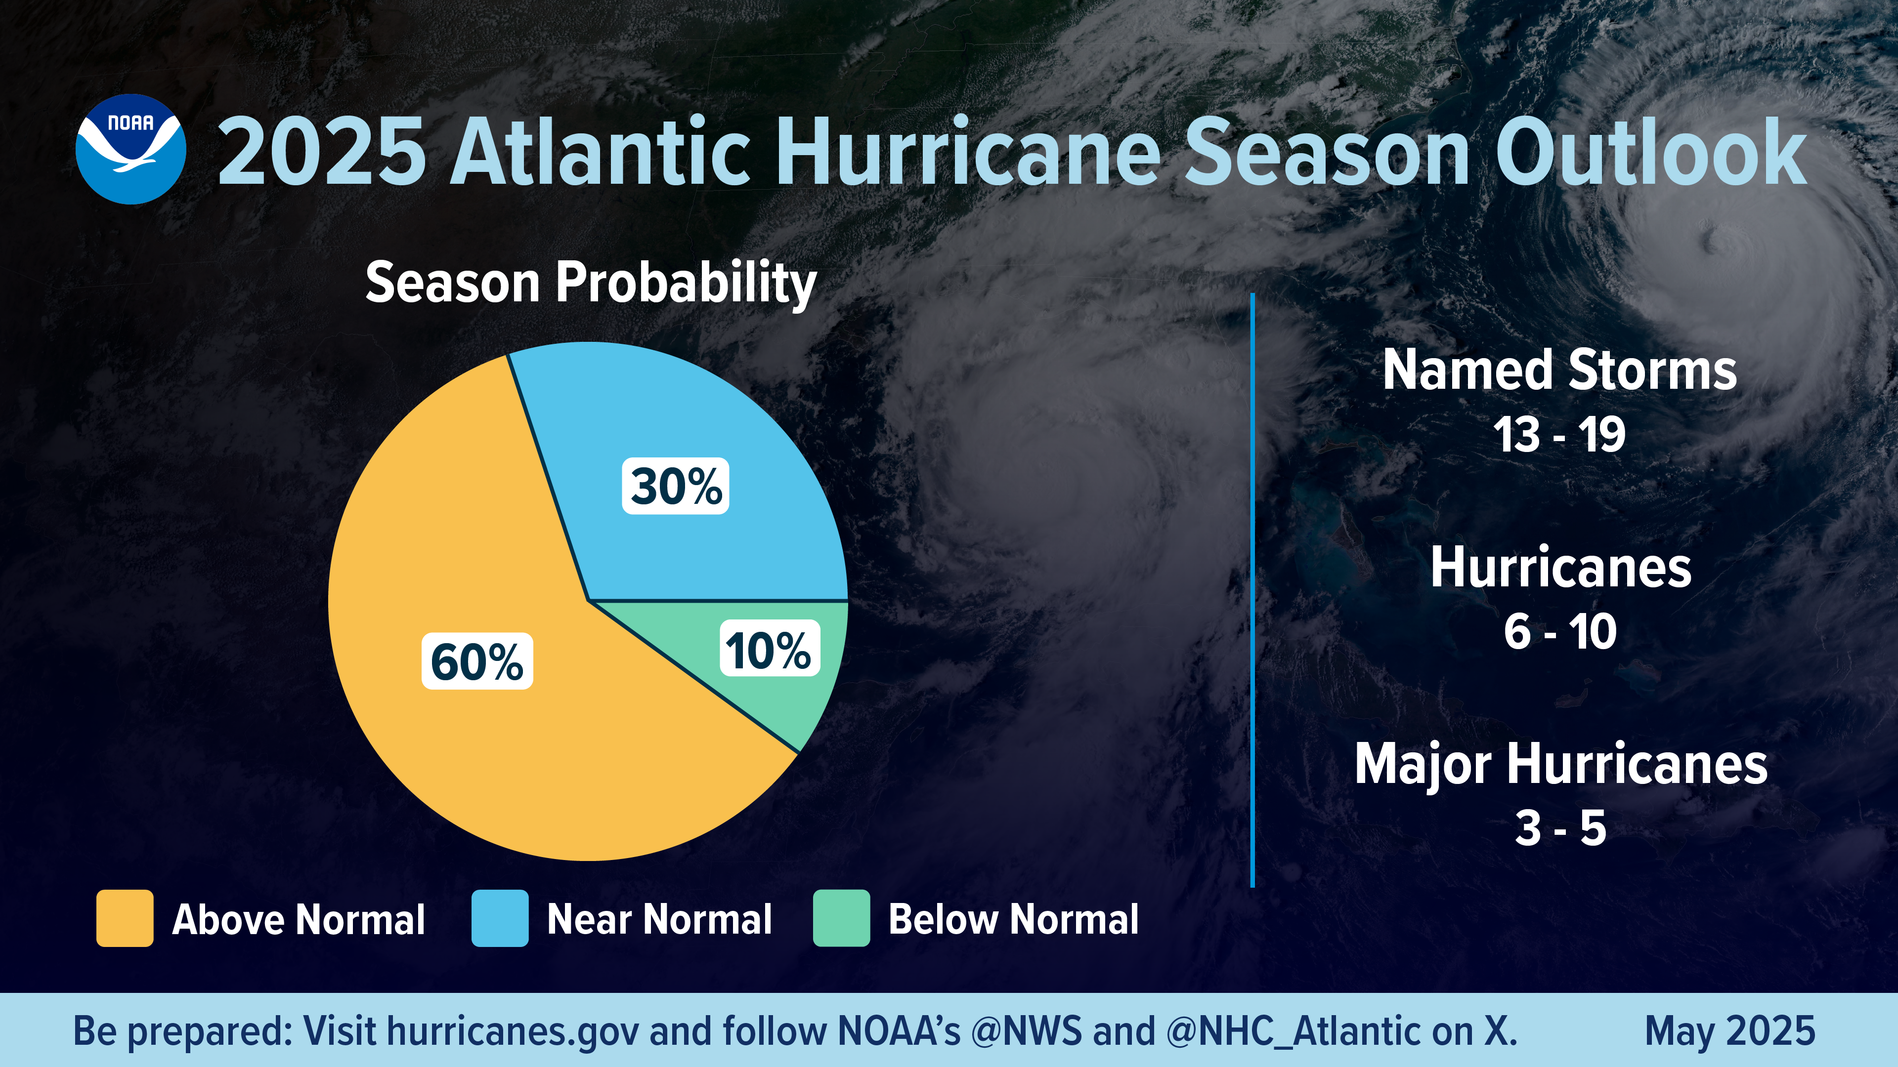
NOAA Predicted Hurricane Activity

Slide 3
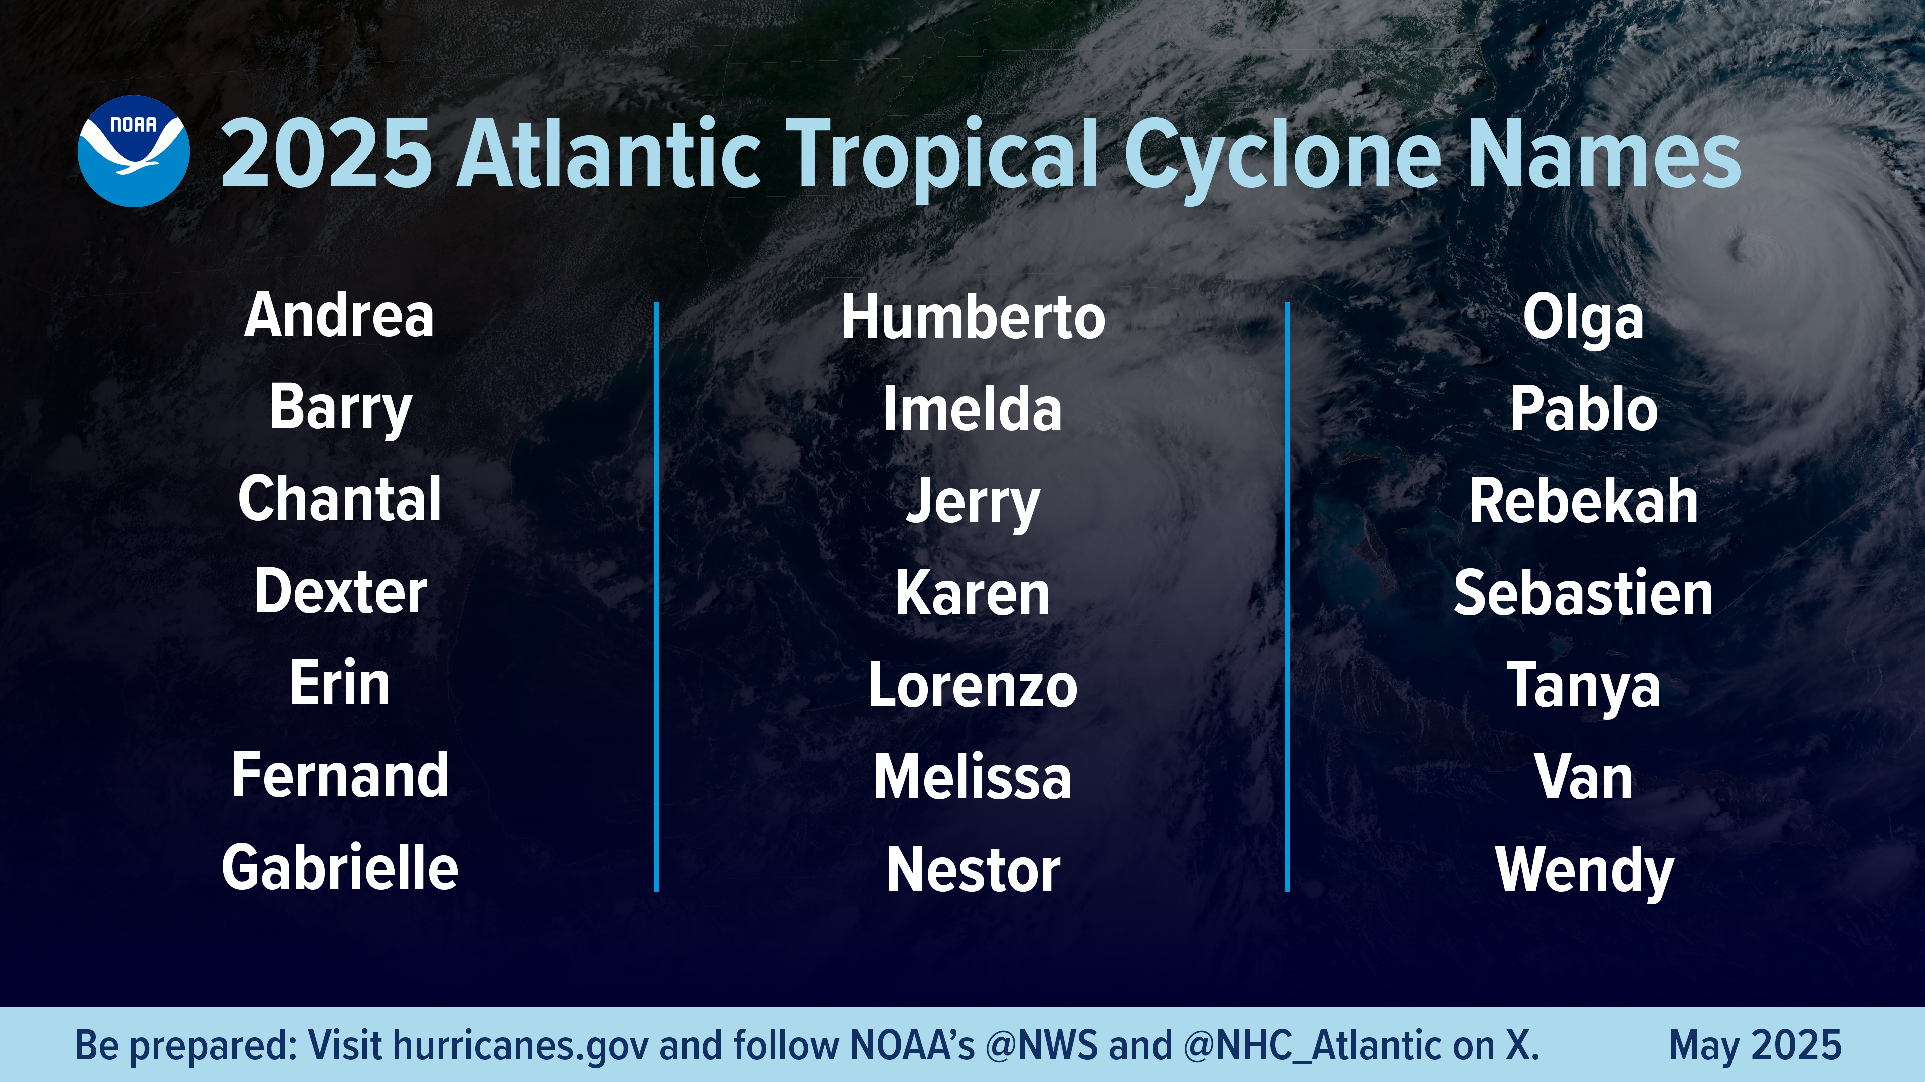

Slide 4
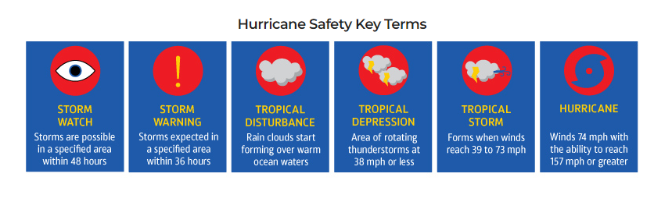
Hurricane Safety Key Terms
The best way to prepare for a tropical storm or hurricane is to understand their definitions and follow procedure. Knowing key terms and phrases can help build an understanding of when a life-threatening situation may occur and how to react.

Slide 5
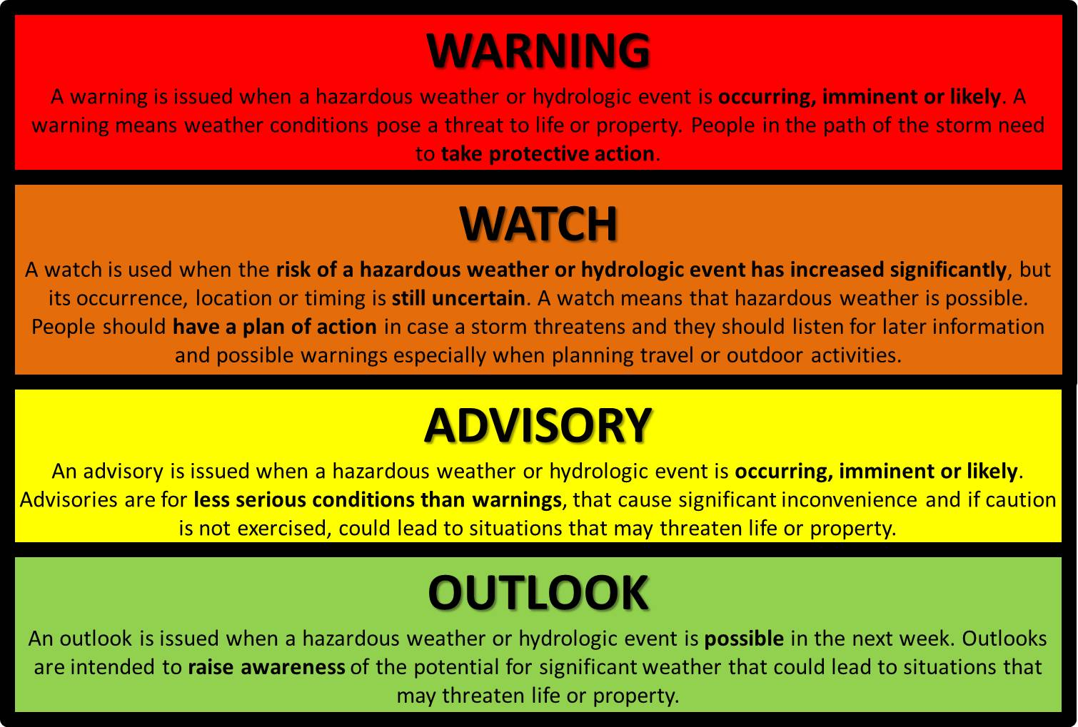
Hurricane Advisories

Slide 6
PREPARE ACTION
OUTLOOK
ADVISORY
WATCH
WARNING
Issued 3-5 days before the onset of potential significant weather
Issued as a Special Weather Statement of significant areas of disturbed weather and potential for development in the next 5 days
Highlights the potential for significant hurricane weather
Geared towards helping individuals and decision makers plan for hazardous weather
Possible Actions:
  Review action plan
  Continue to actively monitor forecast updates
Issued 36-48 hours in advance of tropical storm/hurricane force winds (can be issued earlier when there is high confidence)
Signifies an increase in forecaster confidence that significant weather is expected to occur
List all potential hazards associated with a tropical storm/hurricane in certain areas
Possible Actions:
  Execute action plan?
  State of preparation resources and response team
Issued 0-36 hours before the onset of hazardous weather
Hazardous conditions will occur, but amounts are not expected to warning criteria
Hurricane and/or Tropical storm conditions are POSSIBLE in Watch Areas
Impacts are expected!
Possible Actions:
  Staff readiness?
  Is action plan being executed/ready to be executed?
  Contingency plans for departments, schools
Issued 0-36 hours in advance of onset of tropical storm or hurricane force winds
Hurricane and/or tropical storm conditions are EXPECTED in Warning Areas
Dangerous weather with significant hazardous impacts expected!
Possible Actions:
  Staff readiness
  Facility readiness
  Resources ready
  Execute action plan
  Execute response team
  All preparations completed

Slide 7
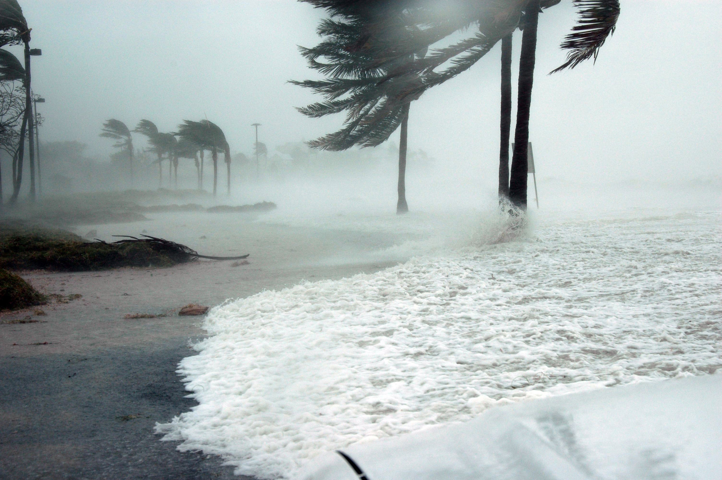
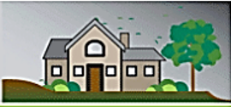


Storm Categories: What Damages to Expect
SAFFIR/SIMPSON HURRICANE SCALE
TROPICAL STORM
Winds: 39-73 mph
Damage: Minimal damage with windy and rainy conditions
Wind Effects: Scattered trees down, scattered power outages, some roads blocked due to downed trees and power lines. For example, neighborhoods could lose power for several days.
CATEGORY 1
Winds: 74-95 mph
Damage: Very dangerous winds will produce some damage
Wind Effects: Damage to mobile structures and some buildings of frame construction. Numerous trees down and widespread power outages. Roads blocked due to downed trees and power lines. Loose outdoor items will become airborne projectiles. For example, several areas could experience near total power loss.
CATEGORY 2
Winds: 96-110 mph
Damage: Extremely dangerous winds will cause extensive damage
Wind Effects: Severe damage to majority of mobile structures and buildings of frame constructions. Considerable damage to shrubbery and some trees blown down. Well-constructed buildings will have damage to roof, siding and gutters. Extensive damage to power lines and widespread power outages. Airborne debris could injure our kill. For example, multiple localities could experience near total loss of power and water for several days.

Slide 8



Storm Categories: What Damages to Expect
SAFFIR/SIMPSON HURRICANE SCALE
CATEGORY 3
Winds: 111-130 mph
Damage: Devastating damage will occur
Wind Effects: Nearly all mobile structures destroyed. Severe damage to most homes and buildings, including structural collapse. Airborne debris will injure or kill. Severe damage to most low-rise buildings with partial roof and wall failure. Foliage blown off trees and large trees blown down. For example, large portions of the affected area could experience total power and water loss for more than a week.
CATEGORY 4
Winds: 131-155 mph
Damage: Catastrophic damage will occur
Wind Effects: Catastrophic damage to residential and commercial structures. Most of the affected area will be uninhabitable for weeks or longer. Nearly all residential buildings severely damaged or destroyed. Major damage to lower floors of structures near shore. Nearly all trees and power poles downed. For example, large portions of the affected area will experience total power and water loss for weeks and possibly months.
CATEGORY 5
Winds: 156+ mph
Damage: Extreme catastrophic damage will occur
Wind Effects: Complete roof failure on many residential and commercial buildings. Some complete building failures with small utility buildings blown away. All shrubs, trees and signs blown down. Complete destruction of mobile structures. Severe and extensive window and door damage. Major damage to lower floors of all structures. For example, large portions of the affected area will experience total power and water loss for weeks and possibly months.

Slide 9
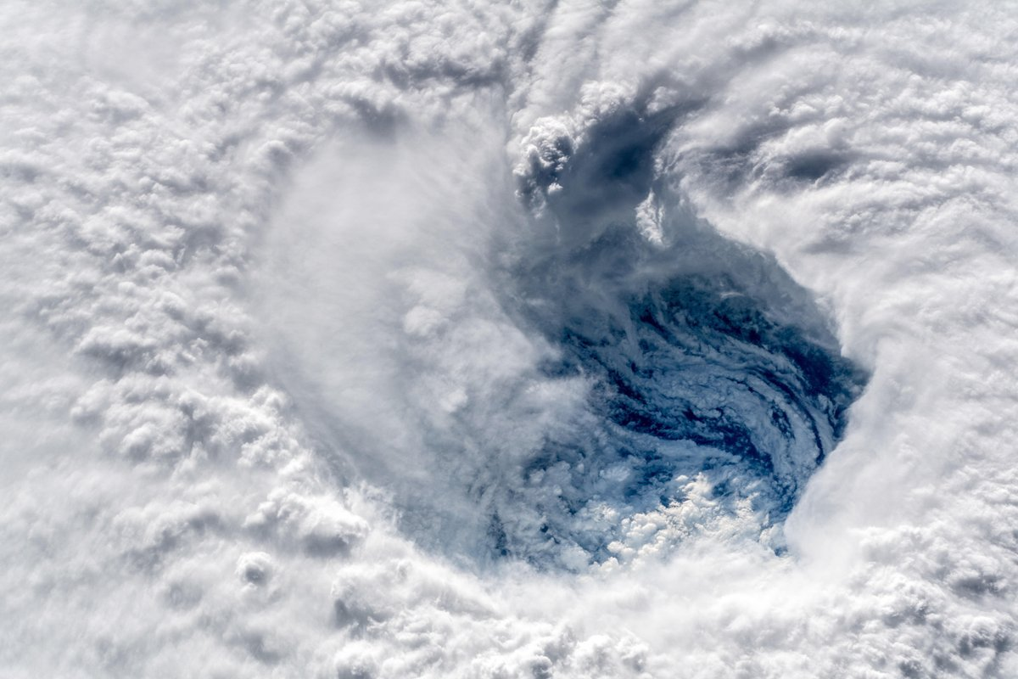
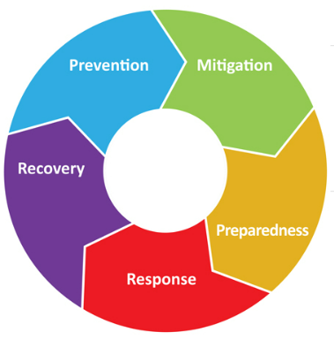
Steps of Emergency Management
Prevention
Actions taken to avoid an incident. Stopping an incident from occurring. Deterrence operations and surveillance.
Mitigation
Refers to measures that prevent an emergency, reduce the chance of an emergency happening, or reduce the damaging effects of unavoidable emergencies. Typical mitigation measures include establishing building codes and zoning requirements, installing shutters, and constructing barriers such as levees.
Preparedness
Activities increase a community's ability to respond when a disaster occurs. Typical preparedness measures include developing mutual aid agreements and memorandums of understanding, training for response personnel conducting disaster exercises to reinforce training and test capabilities and presenting all-hazards education campaigns.
Response
Actions carried out immediately before, during, and immediately after a hazard impact, which are aimed at saving lives, reducing economic losses, and alleviating suffering. Response actions may include activating the emergency operations center, evacuating threatened populations, opening shelters and providing mass care, emergency rescue and medical care, fire fighting, and urban search and rescue.
Recovery
Actions taken to return a community to normal or near-normal conditions, including the restoration of basic services and the repair of physical, social and economic damages. Typical recovery actions include debris cleanup, financial assistance to individuals and governments, rebuilding of roads, key facilities, and sustained mass care for displaced individuals.

Slide 10


Is Your Workplace Ready For A Hurricane?
Without preparation and an adequate disaster recovery plan, consequences have been proven to be catastrophic. Don’t be caught unprepared. See VIDOSH’s Hurricane Preparedness webpage to get your workplace up and running as quickly as possible. Being prepared for a hurricane and knowing exactly how to respond, helps workplaces become resilient and recover faster than figuring it out on the fly.

Slide 11

HURRICANE
PREPARATION TOOLS

